Slide 1

Introduction to Machine Learning
Artificial Neural Networks
By <Trainer’s Name>
<Date>

Slide 2
Artificial Neural Networks
<Topic>

Slide 3

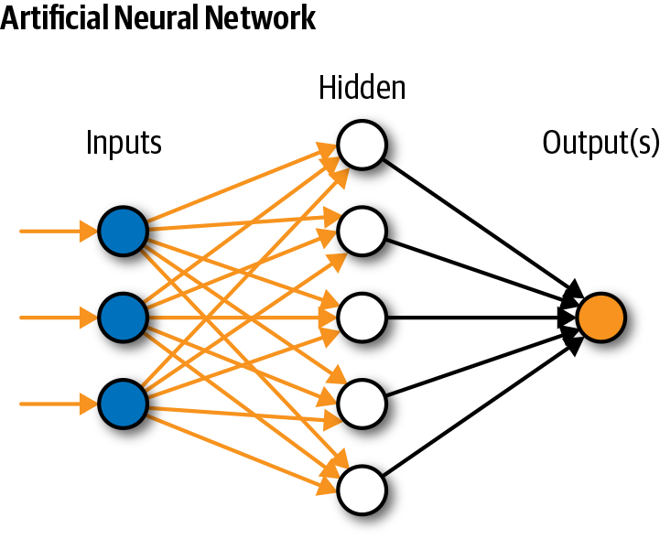
Artificial Neural Network
An artificial neural network consists of a pool of simple processing units which communicate by sending signals to each other over a large number of weighted connections.

Slide 4
Computers vs. Neural Networks
Standard Computers | Neural Networks
One CPU | highly parallel processing
fast processing units | slow processing units
reliable units | unreliable units
static infrastructure | dynamic infrastructure

Slide 5
Why Artificial Neural Networks?
There are two basic reasons why we are interested in building artificial neural networks (ANNs):
Technical viewpoint: Some problems such as character recognition or the prediction of future states of a system require massively parallel and adaptive processing.
Biological viewpoint: ANNs can be used to replicate and simulate components of the human (or animal) brain, thereby giving us insight into natural information processing.

Slide 6
Artificial Neural Networks
The “building blocks” of neural networks are the neurons.
In technical systems, we also refer to them as units or nodes.
Basically, each neuron
receives input from many other neurons.
changes its internal state (activation) based on the current input.
sends one output signal to many other neurons, possibly including its input neurons (recurrent network).

Slide 7
Artificial Neural Networks
Information is transmitted as a series of electric impulses, so-called spikes.
The frequency and phase of these spikes encodes the information.
In biological systems, one neuron can be connected to as many as 10,000 other neurons.
Usually, a neuron receives its information from other neurons in a confined area, its so-called receptive field.

Slide 8
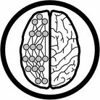
How do ANNs work?
An artificial neural network (ANN) is either a hardware implementation or a computer program which strives to simulate the information processing capabilities of its biological exemplar. ANNs are typically composed of a great number of interconnected artificial neurons. The artificial neurons are simplified models of their biological counterparts.
ANN is a technique for solving problems by constructing software that works like our brains.

Slide 9
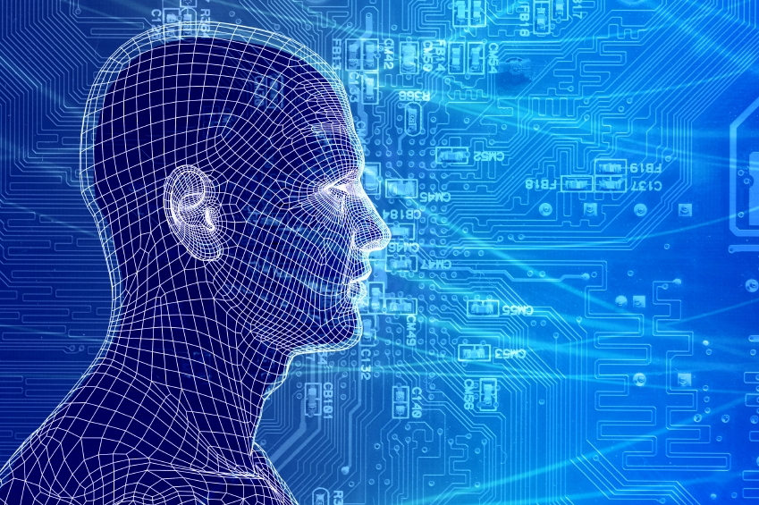
How do our brains work?
The Brain is A massively parallel information processing system.
Our brains are a huge network of processing elements. A typical brain contains a network of 10 billion neurons.

Slide 10
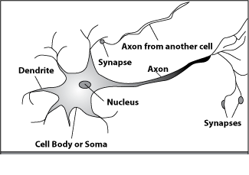
How do our brains work?
A processing element
Dendrites: Input
Cell body: Processor
Synaptic: Link
Axon: Output

Slide 11
How do our brains work?
A processing element
A neuron is connected to other neurons through about 10,000 synapses

Slide 12
How do our brains work?
A processing element
A neuron receives input from other neurons. Inputs are combined.

Slide 13
How do our brains work?
A processing element
Once input exceeds a critical level, the neuron discharges a spike ‐ an electrical pulse that travels from the body, down the axon, to the next neuron(s)

Slide 14
How do our brains work?
A processing element
The axon endings almost touch the dendrites or cell body of the next neuron.

Slide 15
How do our brains work?
A processing element
Transmission of an electrical signal from one neuron to the next is effected by neurotransmitters.

Slide 16
How do our brains work?
A processing element
Neurotransmitters are chemicals which are released from the first neuron and which bind to the Second.

Slide 17
How do our brains work?
A processing element
This link is called a synapse. The strength of the signal that reaches the next neuron depends on factors such as the amount of neurotransmitter available.

Slide 18
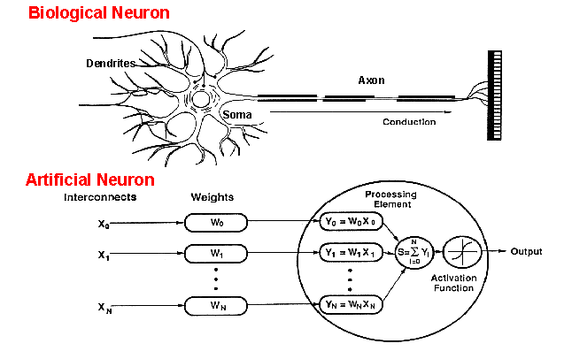
How do ANNs work?
An artificial neuron is an imitation of a human neuron

Slide 19
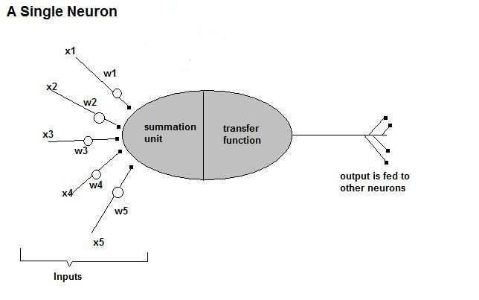
How do ANNs work?
• Now, let us have a look at the model of an artificial neuron.

Slide 20
How do ANNs work?
Input
xm
. . . . . . . . . . . .
x2
x1
∑
Processing
∑= X₁+X₂ + ….+X_{m} =y
Output
y

Slide 21

How do ANNs work?
Not all inputs are equal
xm
. . . . . . . . . . . .
x2
x1
Input
weights
w_{m}
w₂
w₁
. . . . .
Processing
∑
∑= X₁w₁+X₂w₂ + ….+X_{m}w_{m} =y
Output
y

Slide 22

How do ANNs work?
The signal is not passed down to the next neuron verbatim
xm
. . . . . . . . . . . .
x2
x1
Input
w_{m}
w₂
w₁
weights
. . . . .
Processing
∑
Transfer Function (Activation Function)
f(v_{k})
Output
y

Slide 23
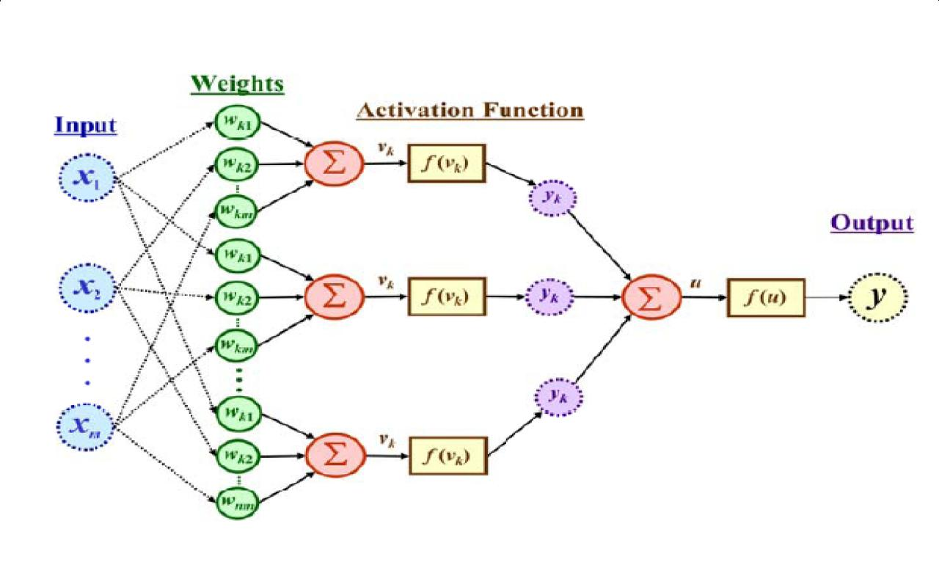
How do ANNs work?
The output is a function of the input, that is affected by the weights, and the transfer functions

Slide 24
Learning by trial‐and‐error
Continuous process of:
Trial:
Processing an input to produce an output (In terms of ANN: Compute the output function of a given input)
Evaluate:
Evaluating this output by comparing the actual output with the expected output.
Adjust:
Adjust the weights.

Slide 25
How it works?
Set initial values of the weights randomly.
Input: truth table of the XOR
Do
Read input (e.g. 0, and 0)
Compute an output (e.g. 0.60543)
Compare it to the expected output. (Diff= 0.60543)
Modify the weights accordingly.
Loop until a condition is met
Condition: certain number of iterations
Condition: error threshold

Slide 26
Design Issues
Initial weights (small random values ∈[‐1,1])
Transfer function (How the inputs and the weights are combined to produce output?)
Error estimation
Weights adjusting
Number of neurons
Data representation
Size of training set

Slide 27
Transfer Functions
Linear: The output is proportional to the total weighted input.
Threshold: The output is set at one of two values, depending on whether the total weighted input is greater than or less than some threshold value.
Non‐linear: The output varies continuously but not linearly as the input changes.

Slide 28
Error Estimation
The root mean square error (RMSE) is a frequently-used measure of the differences between values predicted by a model or an estimator and the values actually observed from the thing being modeled or estimated

Slide 29
Weights Adjusting
After each iteration, weights should be adjusted to minimize the error.
– All possible weights
– Back propagation

Slide 30
Back Propagation
Back-propagation is an example of supervised learning is used at each layer to minimize the error between the layer’s response and the actual data
The error at each hidden layer is an average of the evaluated error
Hidden layer networks are trained this way

Slide 31
Back Propagation
N is a neuron.
N_{w} is one of N’s inputs weights
N_{out} is N’s output.
N_{w} = N_{w} +Δ N_{w}
Δ N_{w} = N_{out} * (1‐ N_{out})* N_{ErrorFactor}
N_{ErrorFactor} = N_{ExpectedOutput} – N_{ActualOutput}
This works only for the last layer, as we can know the actual output, and the expected output.

Slide 32
Data representation
Usually input/output data needs pre‐processing
Pictures
Pixel intensity
Text:
A pattern

Slide 33
Learning Paradigms
Supervised learning
Unsupervised learning
Reinforcement learning

Slide 34
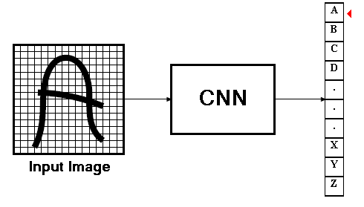
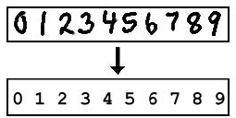
Convolutional Neural Networks
Convolutional neural networks
Signal processing, Image processing
improvement over the multilayer perceptron
performance, accuracy and some degree of invariance to distortions in the input images

Slide 35
Convolutional Neural Networks
CNN’s Were neurobiologically motivated by the findings of locally sensitive and orientation-selective nerve cells in the visual cortex.
They designed a network structure that implicitly extracts relevant features.
Convolutional Neural Networks are a special kind of multi-layer neural networks.

Slide 36
Convolutional Neural Networks
CNN is a feed-forward network that can extract topological properties from an image.
Like almost every other neural networks they are trained with a version of the back-propagation algorithm.
Convolutional Neural Networks are designed to recognize visual patterns directly from pixel images with minimal preprocessing.
They can recognize patterns with extreme variability (such as handwritten characters).

Slide 37
Classification
Classification
f1
f 2
Pre-processing for feature extraction
f1 … fn
Input
Classification
output
Convolutional neural network
Feature extraction
Shift and distortion invariance
classification
Input
output

Slide 38
CNN’s Topology
Feature maps
Feature extraction layer
Convolution layer
C
Shift and distortion invariance or
Subsampling layer
S

Slide 39

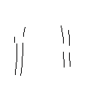
Feature extraction
-1
0
1
Convolve with
Threshold
-1
0
1
-1
0
1
w11
w12
w13
w11
w12
w13
w21
w22
w23
w21
w22
w23
w31
w32
w33
w31
w32
w33

Slide 40


Thank You

